Slide 1

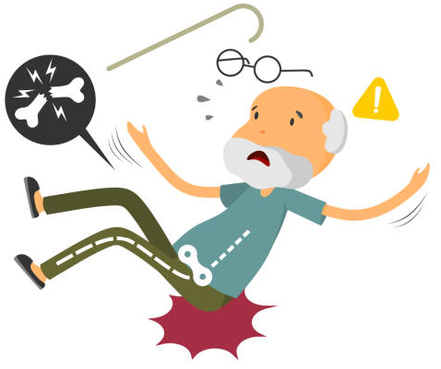


By Ben Lowes, B5PT
Evaluation of patient experience of the falls education group on MTRU
Background
The Major Trauma Rehabilitation Unit (MTRU) has a patients with complex rehab needs who benefit from multiple educational groups to facilitate improved patient outcomes once discharged. Data from 2023-2024 showed 61% of major trauma admissions were as a result of a fall, with ¼ of total admissions being a fall less than 2 meters. The physiotherapy team generally deliver a falls based education group for appropriate patients on the unit weekly or biweekly. The NICE (2013) indicate that falls groups for falls prevention should consist of education on a variety of topics and exercise.
Results/Discussion
The NICE Guidelines for assessing risk and prevention of falls (2013) state intervention should include strength/balance training, diet, footwear, home hazard assessment/intervention, vision assessment/referral and medication review. The group has been developed with the aim to encompass all of the key elements detailed above to ensure patients received the most effective, evidence based practice.
Of the 7 patient questionnaires returned, 100% of patients felt their knowledge of falls prevention had increased. 100% reported increased confidence in reducing risk of falling and 100% reported reduced anxiety and fear of falling from attending the education group.
Patients reported that the key information learnt were; dietary advice, backward chaining, appropriate footwear, education of importance of night lighting/environment and staying vigilant regarding safety of falls.
Patient suggestions for service improvement included; ensuring service delivery remained group based for it’s social element as well as the service providing more educational groups due to the enjoyment of group based participation and patient involvement and inclusivity.
Aim
The falls group is a relatively new group to the MTRU therefore the aim was to establish if this group is clinically effective in improving patients knowledge on falls prevention as well as reducing anxiety and fear of falling.
Conclusion/limiting factors
The MTRU is a 10 bedded unit with a variety of patients with complex rehabilitation needs, ranging from simple falls to high speed road traffic collisions. As such, there is a varying degree of injury and functionality in patients admitted to the unit.
NICE (2013) recommend falls assessment and education is delivered to all patients admitted to hospital following a fall or for patients aged 65+ at risk of falling. This means that this patient group may or may not benefit from this group and it can be the appropriateness of the group attendees is down to clinical discretion.
Another thing to consider is that there is generally an increase length of stay for patients on MTRU due to the complexity of their injuries and social situations. This training would also not be beneficial delivered multiple times for the same patient.
The same therapist delivered the training which was effective in ensuring consistency of service delivery. However, it did not allow for the training to be delivered when annual leave or sickness presents. There is also a training need for the rotational staff member delivering the training which can create a delay in service delivery.
Due to these limitations the sample size was relatively low. However, results demonstrate the group is an effective educational resource, delivered in a cost effective format where all patients reported increase in knowledge of falls prevention, increased confidence in reducing risk of falling and reduced fear and anxiety of falling.
Methods
Falls education group established in line with NICE (2013) guidelines.
Quantitative/Qualitative questionnaire devised.
Weekly delivery of group, led by a physiotherapist and rehab assistant.
Data was collected over a 3 month period.
Questionnaire to evaluate post session.
Collation of results to understand key themes.
Future considerations
To ensure consistency in delivery of the falls education group via in-service training for all new rotational staff.
To explore the delivery of the group by additional staff for when cover is required.
To explore and implement other educational groups.
References: NICE (2013) Falls in older people: Assessing risk and prevention. Available at: https://www.nice.org.uk/guidance/cg161/resources/falls-in-older-people-assessing-risk-and-prevention-pdf-35109686728645 (Accessed: 27 August 2024).

