Slide 1

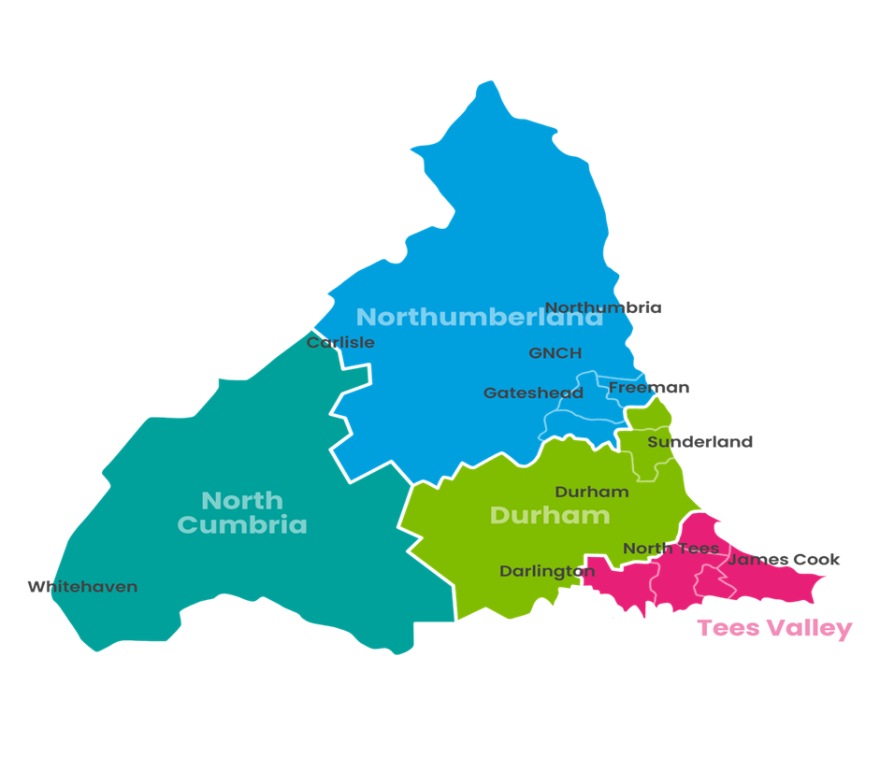
Radiology Research North East and North Cumbria (NENC)
Clare Moody – Regional Lead Research Radiographer
Georgia Williams – Regional Radiology Project manager
Notes:
We are both here to help educate our Radiology workforce about the wonderful world of research and how you can implement research into your current job role.
We are both on a 1-year secondment through the Imaging Academy and NIHR to work with our 8 regional Trusts to deliver Radiology Research.
I’ll start by telling you about our aims for radiology research……

Slide 2
aims for Research in Radiology
Embed radiology research into clinical practice
Promote and raise profile of research within Radiology so it is part of Directorate aims and goals
Build on and improve current radiology research capacity and capability
Develop infrastructure to support and build radiology-led research
Implement robust methods for monitoring research activity
…………..to achieve this in our region we need to work together…
Notes:
1 – to enable a research culture.
4- Not just supporting other peoples’ research with imaging, I’m talking about radiology LED research which is improving our practices or procedures or enhancing the patient experience or their care pathway within radiology.
5 – A common theme in the region is that research activity in radiology goes un-documented. We want to encourage all of the regional Trusts to document all of the imaging they do for research studies. This will help prove how research active our Radiology departments are which could lead to research funding being more favourable to Radiology and this can be ploughed back into Radiology to support Radiology led research.

Slide 3


What are we currently doing?
Visiting hospital sites on teams and in person
What levels of radiology research are undertaken at different sites?
Who are the ‘go to’ research people at each site?
What does each site need from us?
What are the research interests and can we match them with others in the region?
Scoping exercise via a radiology research survey
Notes:
We are visiting hospital sites armed with information such as how to get started in doing some research & what funding is available. Radiology staff attend to explore their research ideas, find out what research is happening at other radiology sites, or just have a chat and see if anything sparks their interests….and of course we entice them for a chat with some freebies too!
(Last point) All of these questions were covered in a scoping survey which ended at the beginning of this month so we are busy analysing the data and working on how we can deliver what the region requires.

Slide 4
Plans for the next 6 months
Provide in person drop-in sessions at all 8 trusts
Work with the radiology teams to help research collaborations across sites
Educate and support people to step outside of their comfort zones and present some research
Educate student radiographers about research – pilot rotation at NUTH
Notes:
Drop in sessions to chat with radiology about the results of the survey and how we can deliver on their individual needs.
Work with teams to help collaborations across sites – expanding our current roles to include research is a way of promoting and consolidating our professional identity.
We want to support people to step outside of their comfort zones and share the work that they have done.
We have worked with our Radiology Clinical Educators in Newcastle to give student Radiographers some hands-on experience of research.
3rd year students
In Jan - 1 or 2 days to shadow the research team
Get feedback from the students and the radiology team to see if this can be rolled out in the region.

Slide 5
Radiology Research
Ongoing Strategy
Enable Radiology teams to support research within their roles.
Create and nurture research connections between hospital Trusts
Consolidate our professional identity
Notes:
This isn’t a quick fix over 6-12months. We have an ongoing strategy to bring Radiology Research into the limelight.

Slide 6

Contacts
Clare.moody1@nhs.net
Georgia.williams11@nhs.net
Notes:
Futures web page is designed to educate and support you through all aspects of Radiology Research. You can use the forum to ask any research questions, no matter how small. This is a safe, supportive space for you to find out what is happening throughout the region and see what collaborations you can make!
This is an AHP celebration day so I should point out that even if you are not a Radiographer, our NHS Futures page will be useful to you. It has funding and research information that is valid and current for all AHP’s too. Feel free to give us some feedback as this is a new venture so your comments and thoughts are appreciated.
If you have any questions you can contact myself or Georgia via email.
Thanks for listening.

