Slide 1
Reducing Antibiotic Delays for Podiatry Patients in Community
Emma Jenks – Advanced Podiatrist

Slide 2
The Problem?
Podiatrists see foot infection on a regular basis.
It takes time for the patient to get antibiotics after a request is sent to the GP.
TIME IS TISSUE!

Slide 3
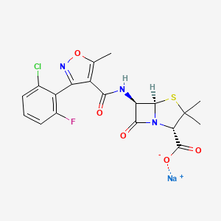
Perceived Solution
Podiatrists qualify with Prescription Only Medicines - Sale and Supply.
Podiatrists have a limited formulary of most interest would be;
Flucloxcillin
Amoxicillin
Erythromycin
What if we used this?

Slide 4
Keeping it Evidence Based: Audit Time!
Data was collected over four months using a task on SystmOne.
We wanted to identify;
Length of delay? Number of days between date of request and date of issue.
Which Antibiotic was Prescribed?
Whether a sample was taken for Microbiology as per clinical guideline?
Was the infection resolved at one week?

Slide 5
Results

Slide 7
Conclusion
Some patient’s experienced significant delays.
Patient’s were predominantly prescribed Flucloxacillin 500mg QDS.
Infections often resolved on 1 week of antibiotics.
Implementation of POM-S for Podiatrists should reduce delays for patient’s requiring antibiotics.

Slide 8
What have we done?
Updated POM-S qualification for Podiatrists to be able to issued Flucloxacillin 500mg QDS for Community Clinics at the time of presentation.
Pharmacy approval.
Created Standard Operating Procedure.
Started March 2024.

Slide 9
What Next?
Addition of PGDs to expand formulary
Re-Audit
Could this be implemented at more sites?
Could we issue from Home Visits?
Addition of more Independent Prescribers to the Department.

