Slide 1

Plastics Reduction Guidance Community Home Enteral Tube Feeding Dietitians
Helen Harrison
Lead HETF Dietitian (Newcastle Nutrition)

Slide 2
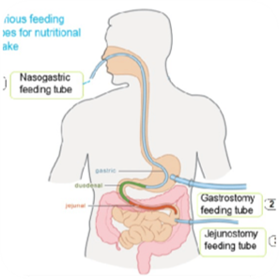

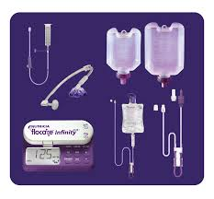

Discharge process with new enteral feeding tube:
A patient receiving enteral tube feeding in hospital is medically stable.
Plans are made to discharge back to their own home or residential care.
10 days’ provision of feed, medication, tube ancillaries and feeding pump if appropriate are provided by managing ward.
Patient is registered with an enteral feed contract provider to include delivery of feed and plastic ancillaries, out of hours support and nursing service provision
https://www.nutricia.com/TubeFeedingAwareness.html

Slide 3

Driver for guideline development
Net Zero for Carbon (2040)
Regional cohesion
Cost
Drivers for guideline development
How:
Substantial reduction in plastic feeding
ancillaries on discharge / new registration
Eliminating single use plastics
Focus on pressure points:
Containers / bottles and enteral syringes
Under 1 year old
Post-pyloric feeding
Change habitual practice
Stakeholders: Acute and Community Dietetics, Community Nursing , Regional HETF teams, Infection Prevention Control
Notes:
Mimic acute provision
No evidence base

Slide 4
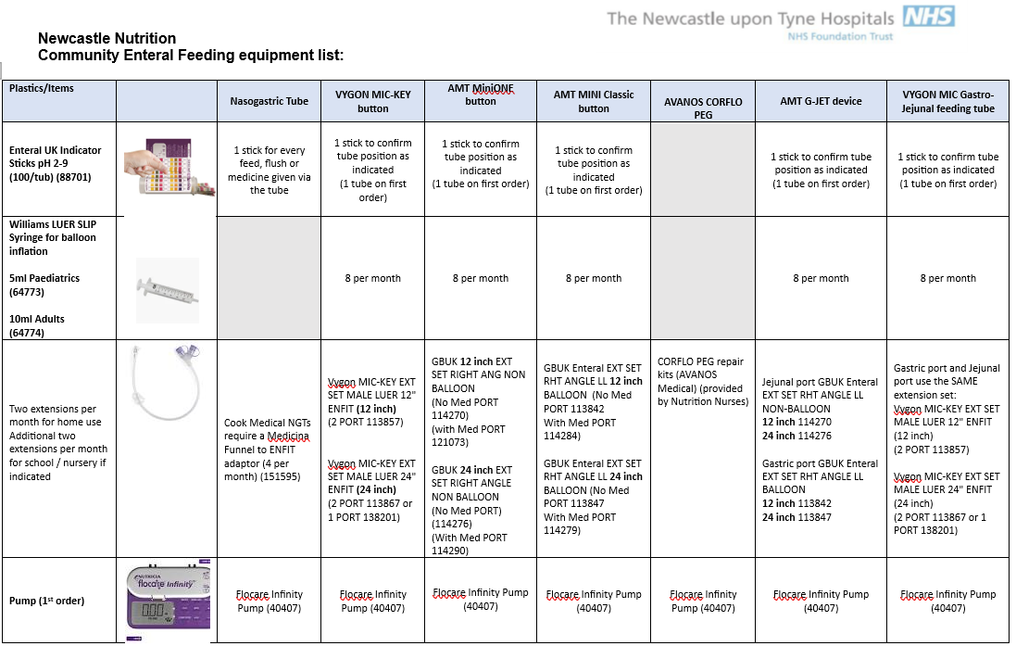
Community Home Enteral Feeding equiptment guidelines 2024 Newcastle Nutrition.docx

Slide 5
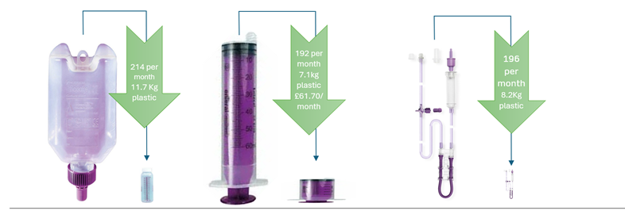
Example: 3 hourly feeds (8 per day); infant pump fed.

Slide 6
Going forward:
Extend to existing service users
Connection with other interested HCPs
Giving set / pack sets opt out
Data on cost and plastic savings after 6m/ 12months
Regional agreement
BAPEN / regional and national showcase

