Slide 1


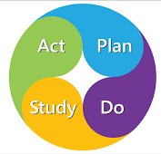
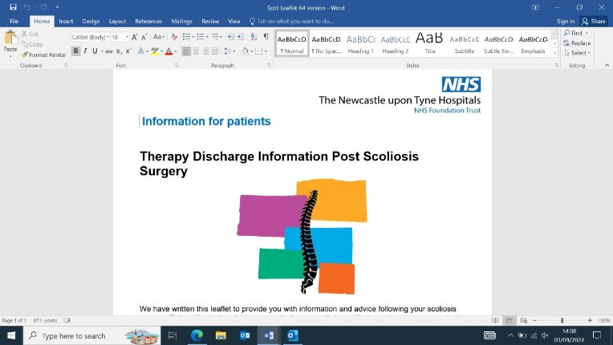
Enhancing quality of care and service provision for post adolescent idiopathic surgery patients through development of a therapy information leaflet and video
Hannah Brusby – Paeds Orthopaedic
Final leaflet feedback themes:
Results:
"Helpful to know what I can and can't do"
AIM: Develop a therapy focused information leaflet and introductory video for adolescent idiopathic scoliosis (AIS) patients undergoing corrective surgery at the RVI.
Background:
Previous projects completed by the paediatric spinal team, concluded from service user feedback a therapy focused pre/post AIS surgery leaflet and introductory video would be useful.
NHS England (2023) advise clear and accessible information/ communication from first point of contact is vital for all elective surgeries.
The trust vision emphasises delivering the highest standard of service and values innovation by continuing to respond to patient feedback. The Allied Health Professionals (AHPs) Strategy for England 2022 to 2027 highlights the importance of utilising collaboration with other health colleagues to promote person/community centred care. This strategy supports self-care through patient focused leaflets to reduce pressure on healthcare services.
Draft leaflet feedback themes:
Simplify wording
Adapt format into A4 for trust approval
Bullet points would be easier to follow
PATIENTS:
"Would help me feel more confident going home"
"Feel more confident to help plan return to school"
PARENTS:
"Easy to follow and understand"
"Good resource for staff working weekends"
"Know from experience this answers the most asked questions from patients on the ward"
PROFESSIONALS:
"I like the photos and design"
Method:
Leaflet:
Discussed leaflet with spinal MDT, developing content and design.
Distributed leaflet to post AIS surgery patients on ward and collected feedback.
Feedback collected from parents, professionals, spinal consultants as well as regional scoliosis day.
Submitted leaflet to trust approval team, currently awaiting review for distribution.
Video:
reviewed other national centres and formed a questionnaire for patient feedback/ ideas
Regular communication with MDT (ward sister, specialist nurse, therapy team) to develop video content.
Met medical photography to discuss video process/content.
- Currently still undergoing plan for filming.
Figure 2: PDSA Model
Helps increase indirect communication with patients
Conclusion:
Provided reassurance and increased confidence for patients/parents
Improved communication and quality of care
Improved staff confidence and understanding for weekend work
National scoliosis interest group are developing a gold standard of care for AIS patients post op –seniors will share leaflet with national centres
Next steps...
Seniors to feedback to the national scoliosis group
MDT to continue filming of video and collect feedback from patients/ parents/ MDT/ other professionals
Develop information leaflets for schools/colleges
Develop therapy information leaflets for other conditions
Impact on service delivery/patient care:
PATIENT LEVEL: Increased confidence and
provided reassurance
TRUST: Responded to patient feedback,
improved patient experience, improved
standard of service
NATIONAL LEVEL: Improved
accessibility, aligns with AHPs strategy
promoting collaborative work and self-care
Figure 1: Therapy Information Leaflet
Limitations:
Time Pressures
Patient engagement
Planning/ logistics/ staff availability

